Slide 1
DATA ANALYSIS PRESENTATION AND INTERPRETATION By Udochukwu Orji & Sandra Ezeora

Slide 2
Table of contents
1. Introduction
2. Problem Statement
3. Methodology
4. Recommendations
5. Conclusion
6.Future Findings
7. Acknowledgements

Slide 3
INTRODUCTION
In data analysis, different tools are also used to achieve results, e.g...MYSQL,EXCEL,R, TABLEAU, POWER BI etc..
The dataset is from KAGGLE ( USA EDUCATIONAL FINANCE)
Hypothesis _____ There were more investment in public education during Barrack Obama tenure than any other USA president.
Public education in the USA is funded through a combination of federal, state, and local sources. The federal government allocates funds for national education programs, while states primarily finance education based on factors like enrollment and tax revenue.
Local funding, mainly from property taxes, also plays a significant role. Disparities in funding can occur due to variations in property values. Additionally, public education may receive funds from grants, donations, and private partnerships.
In this datasets , we have headings like year, enrollment, states, total revenue , total expenditure, revenue per capital which we calculated by ourselves and President and their tenure which also added by functions.

Slide 4
QUESTIONS / HYPOTHESIS 1. There were more investment in public education during Barrack Obama tenure than any other USA president. 2. Different funding between federal, local and state… 3. What is the revenue per capital during president tenure? 4. What are the top 5 states with the high and low final amount ? 5. What are the top 5 states with high total revenue and high total expenditure? 6. What are percentage different in yearly total revenue? 7 .Different funding between federal, local and state…

Slide 5
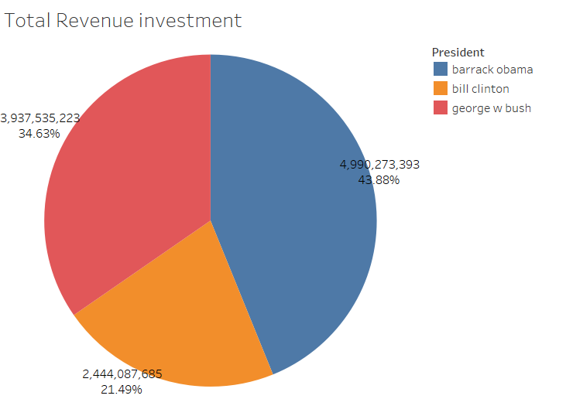
1.There were more investment in public education during Barrack Obama tenure than any other USA president.

Slide 6
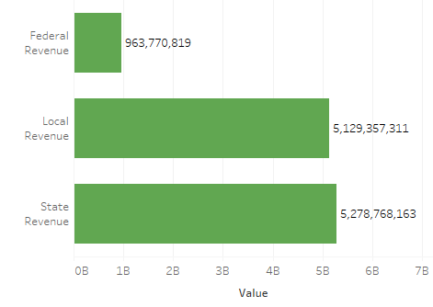
2.What are percentage difference in yearly total revenue?

Slide 7
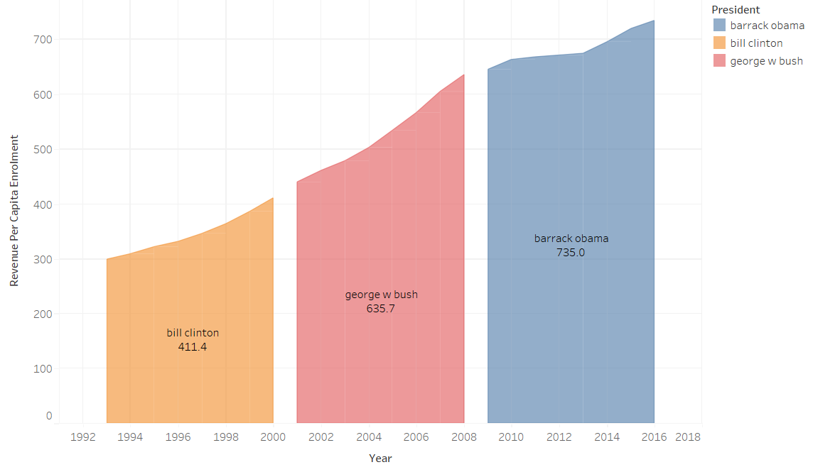
3. What is the revenue per capital of during president tenure ?

Slide 8
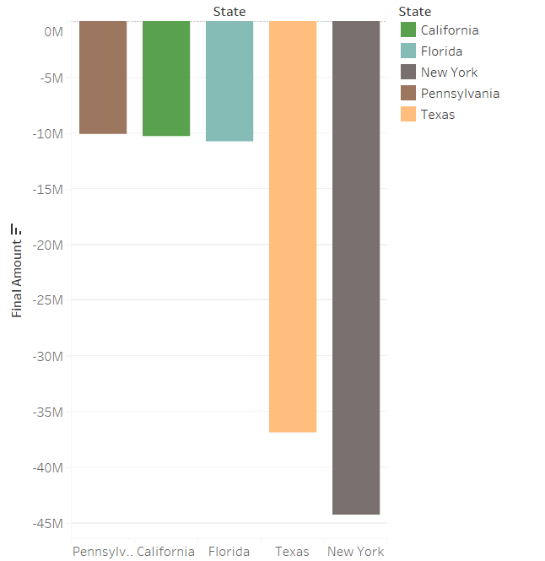
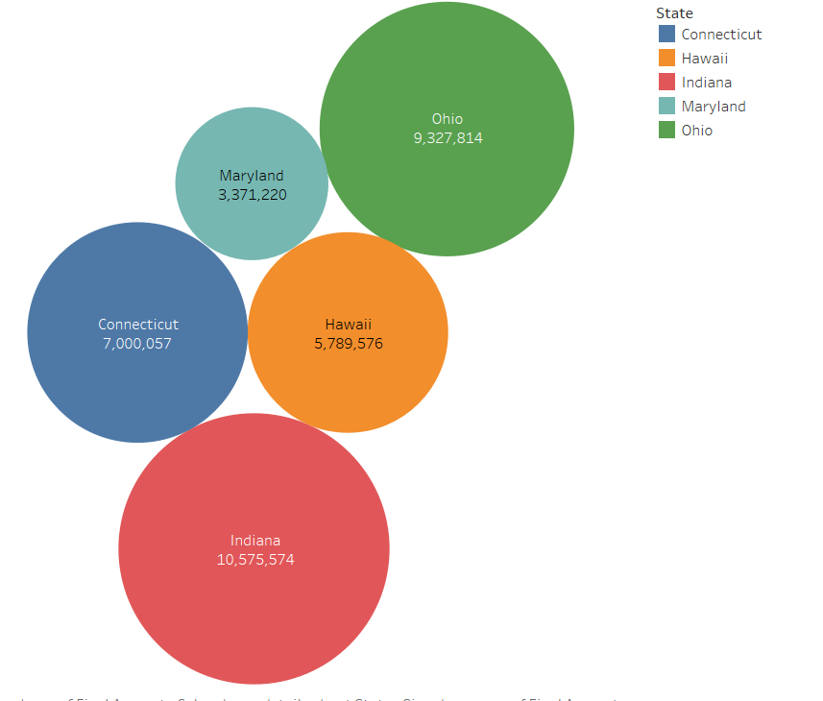
3. What are the top 5 states with the high and low final amount ?

Slide 9
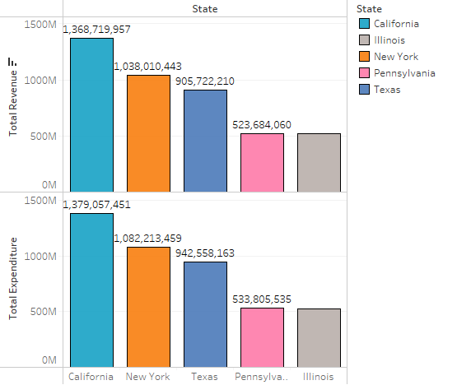
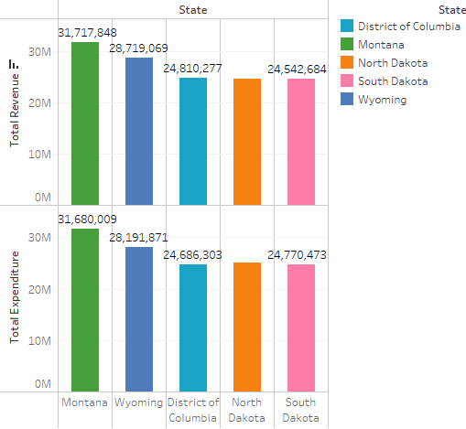
5. What are the top 5 states with high total revenue and high total expenditure.?

Slide 10
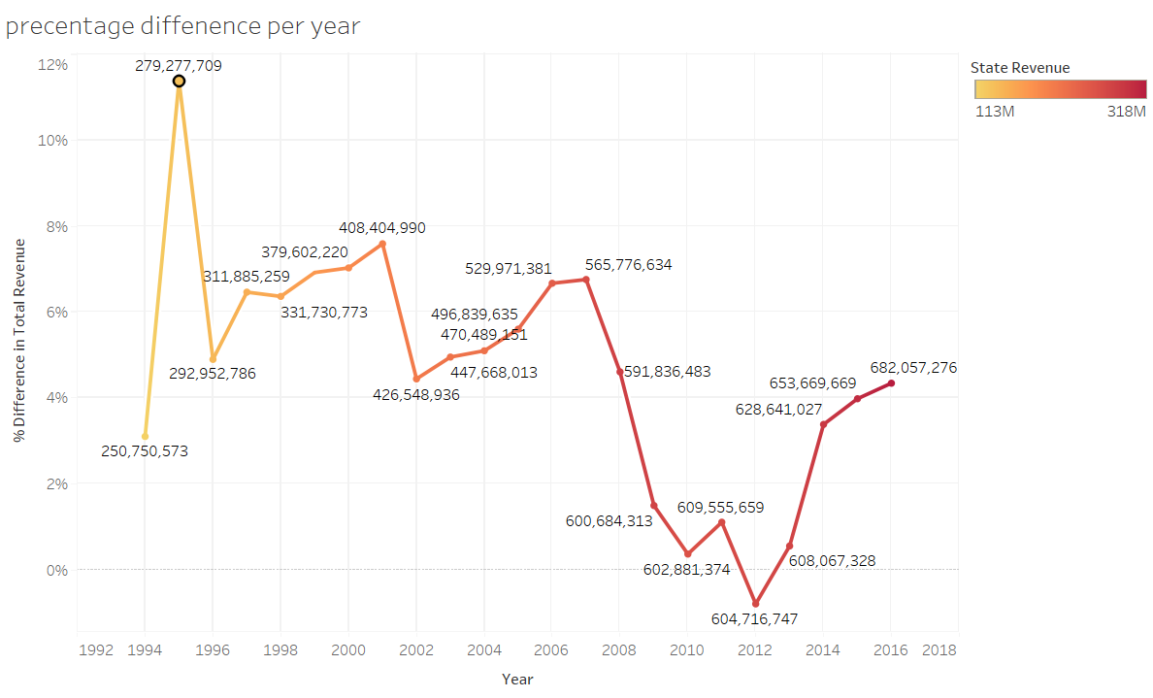
2.What are percentage different in yearly total revenue?

Slide 11
METHODOLOGY 1.Get Dataset From Kaggle 2. Data Cleaning & Formatting 3. Import To MYSQL 4.Import To Tableau And To Create Visualization. 5. There are different ways of presenting data, textual, tabular and graphical forms, which less technical but logical & sequential.

Slide 12
FUTURE FINDINGS
QUS.. WOULD I SAY THERE IS LIMITIATIONS ?
ANS.. NO
With time and future finding, I believe the results will be positive.
They will be improvement with more enrollment, revenue will be generated through funds from property taxes , grants, donations, and private partnerships.
Future findings on educational funding in the USA are likely to shed light on the continued challenges and potential solutions for ensuring equitable and adequate resources for all students.

Slide 13
RECOMMENDATIONS
1.If the state have more enrollment they will get more fund.
2.Any state that has fund should invest more in public schools.
3. Barack Obama’s legacy should be emulated, what even policy he used should be studied.
4. Diversify funding sources : Public education should explore additional funding sources beyond federal, state, and local government funding.
5. Increase federal funding: The federal government should increase its funding for education programs, particularly those that support disadvantaged students and promote educational equity.

Slide 14
INSIGHT/ CONCLUSION
During Barrack Obama tenure there were more investment than any USA president ,
State fund has a great impact in education funding, United States relies primarily on state and local funding , with just a tiny share of total revenues allotted by the federal government…
Total revenue minus total expenditure gave total amount.. Total expensive are more than total revenue.
Revenue per capital during president tenure was consistency but Barrack Obama out performer Bill Clinton & George W Bush.
State with high final amount spent less than their generated revenue as a result of low enrollment, funds were used to accomplish task while states with high total expenditure spent more than their allocation due to high enrollment.
There was Between 1994 rise to 279,277,209 and dropped less than 604,716,747.

Slide 15
ACKNOWLEGDEMENT
I would like to begin by expressing my heartfelt gratitude to the almighty God for guiding and helping me throughout my journey.
I also want to extend my sincere appreciation to my brother Christian Orji for his unwavering support and encouragement. His constant reminders and calls to ensure that I have downloaded MYSQL were a great help.
I am also grateful to Ana Martins, my Lead instructor, for being approachable and always having a listening ear. Even when the learner support was not supportive, she was always there to lend a helping hand.
My special thanks go to Mrs. Tanaya, who has been awesome and always ready to help me.
I also want to express my appreciation to the rest of the class, including Mr. Osa, Emma, Yoyin, Lucy, Lawrence, Josh, Dani, Platini, and Ruhell. It was a pleasure to be in the same class with you all from different parts of the world. Your presence and contributions made the learning experience unforgettable. And to my humble self for standing strong despite all odes
Once again, thank you all for your support, encouragement, and understanding. I am deeply grateful for your presence in my life.

Slide 16
THANK YOU dhanyavad xièxiè DALU MECERIC Ù rú èsé "OBRIGADA/OBRIGADO”

